Slide 1




DESAFIO
Gere planos de ação a partir de análises com SQL

Slide 2
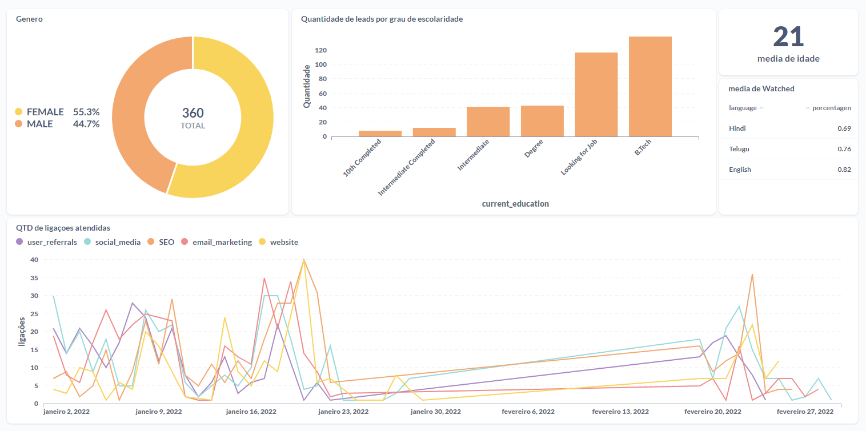
Dashboard

Slide 3
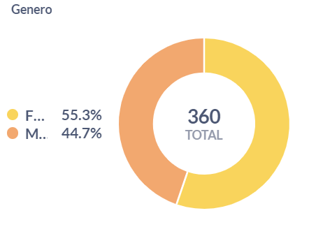
Gráfico 1 - PIZZA
SELECT
`source`.`gender` AS `gender`,
`source`.`Qtd.` AS `Qtd.`
FROM
(
select
(gender),
count(*) as "Qtd."
from
leads_basic_details
group by
gender
) AS `source`
LIMIT
1048575

Slide 4
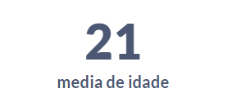
Gráfico 2 - CARTÃO
SELECT
AVG(`leads_basic_details`.`age`) AS `avg`
FROM
`leads_basic_details`

Slide 5
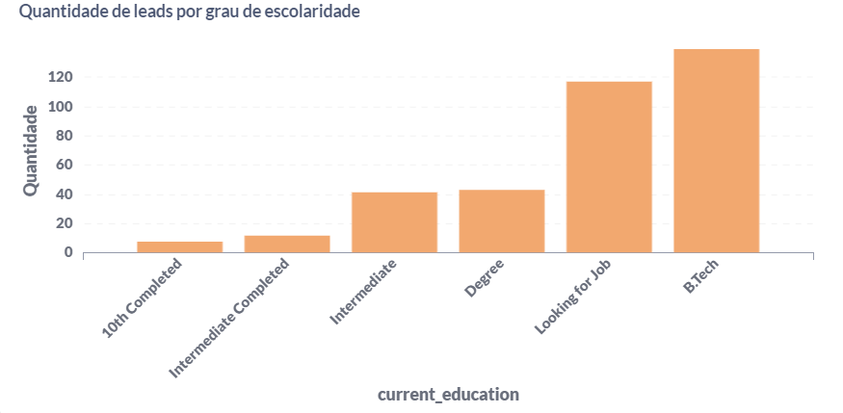
Gráfico 3 - BARRAS
select
count(lead_id) as QTD_pessoas , current_education
from leads_basic_details
group by current_education
order by QTD_pessoas

Slide 6
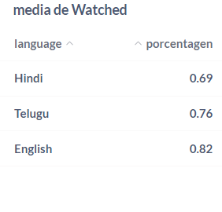
Gráfico 4 - TABELA
select
language, avg(watched_percentage)
from leads_demo_watched_details
where
watched_percentage > 0.5
group by language
order by avg(watched_percentage)

Slide 7
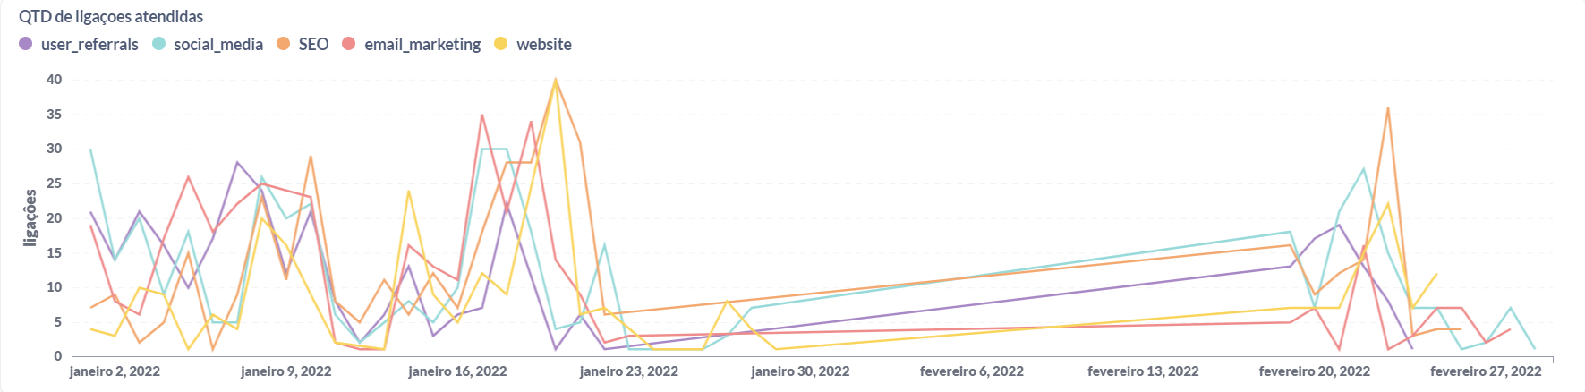
Gráfico 5 - LINHAS
.
WITH sucessful_calls AS (SELECT * FROM leads_interaction_details
WHERE LOWER(call_status) = 'successful')
SELECT CAST(call_done_date as date) call_done_date, lead_gen_source,
count(*) as leads_interaction_details
FROM sucessful_calls as sc
LEFT JOIN leads_basic_details as lbd ON sc.lead_id = lbd.lead_id
GROUP by call_done_date, lead_gen_source
ORDER BY call_done_date

